Slide 1
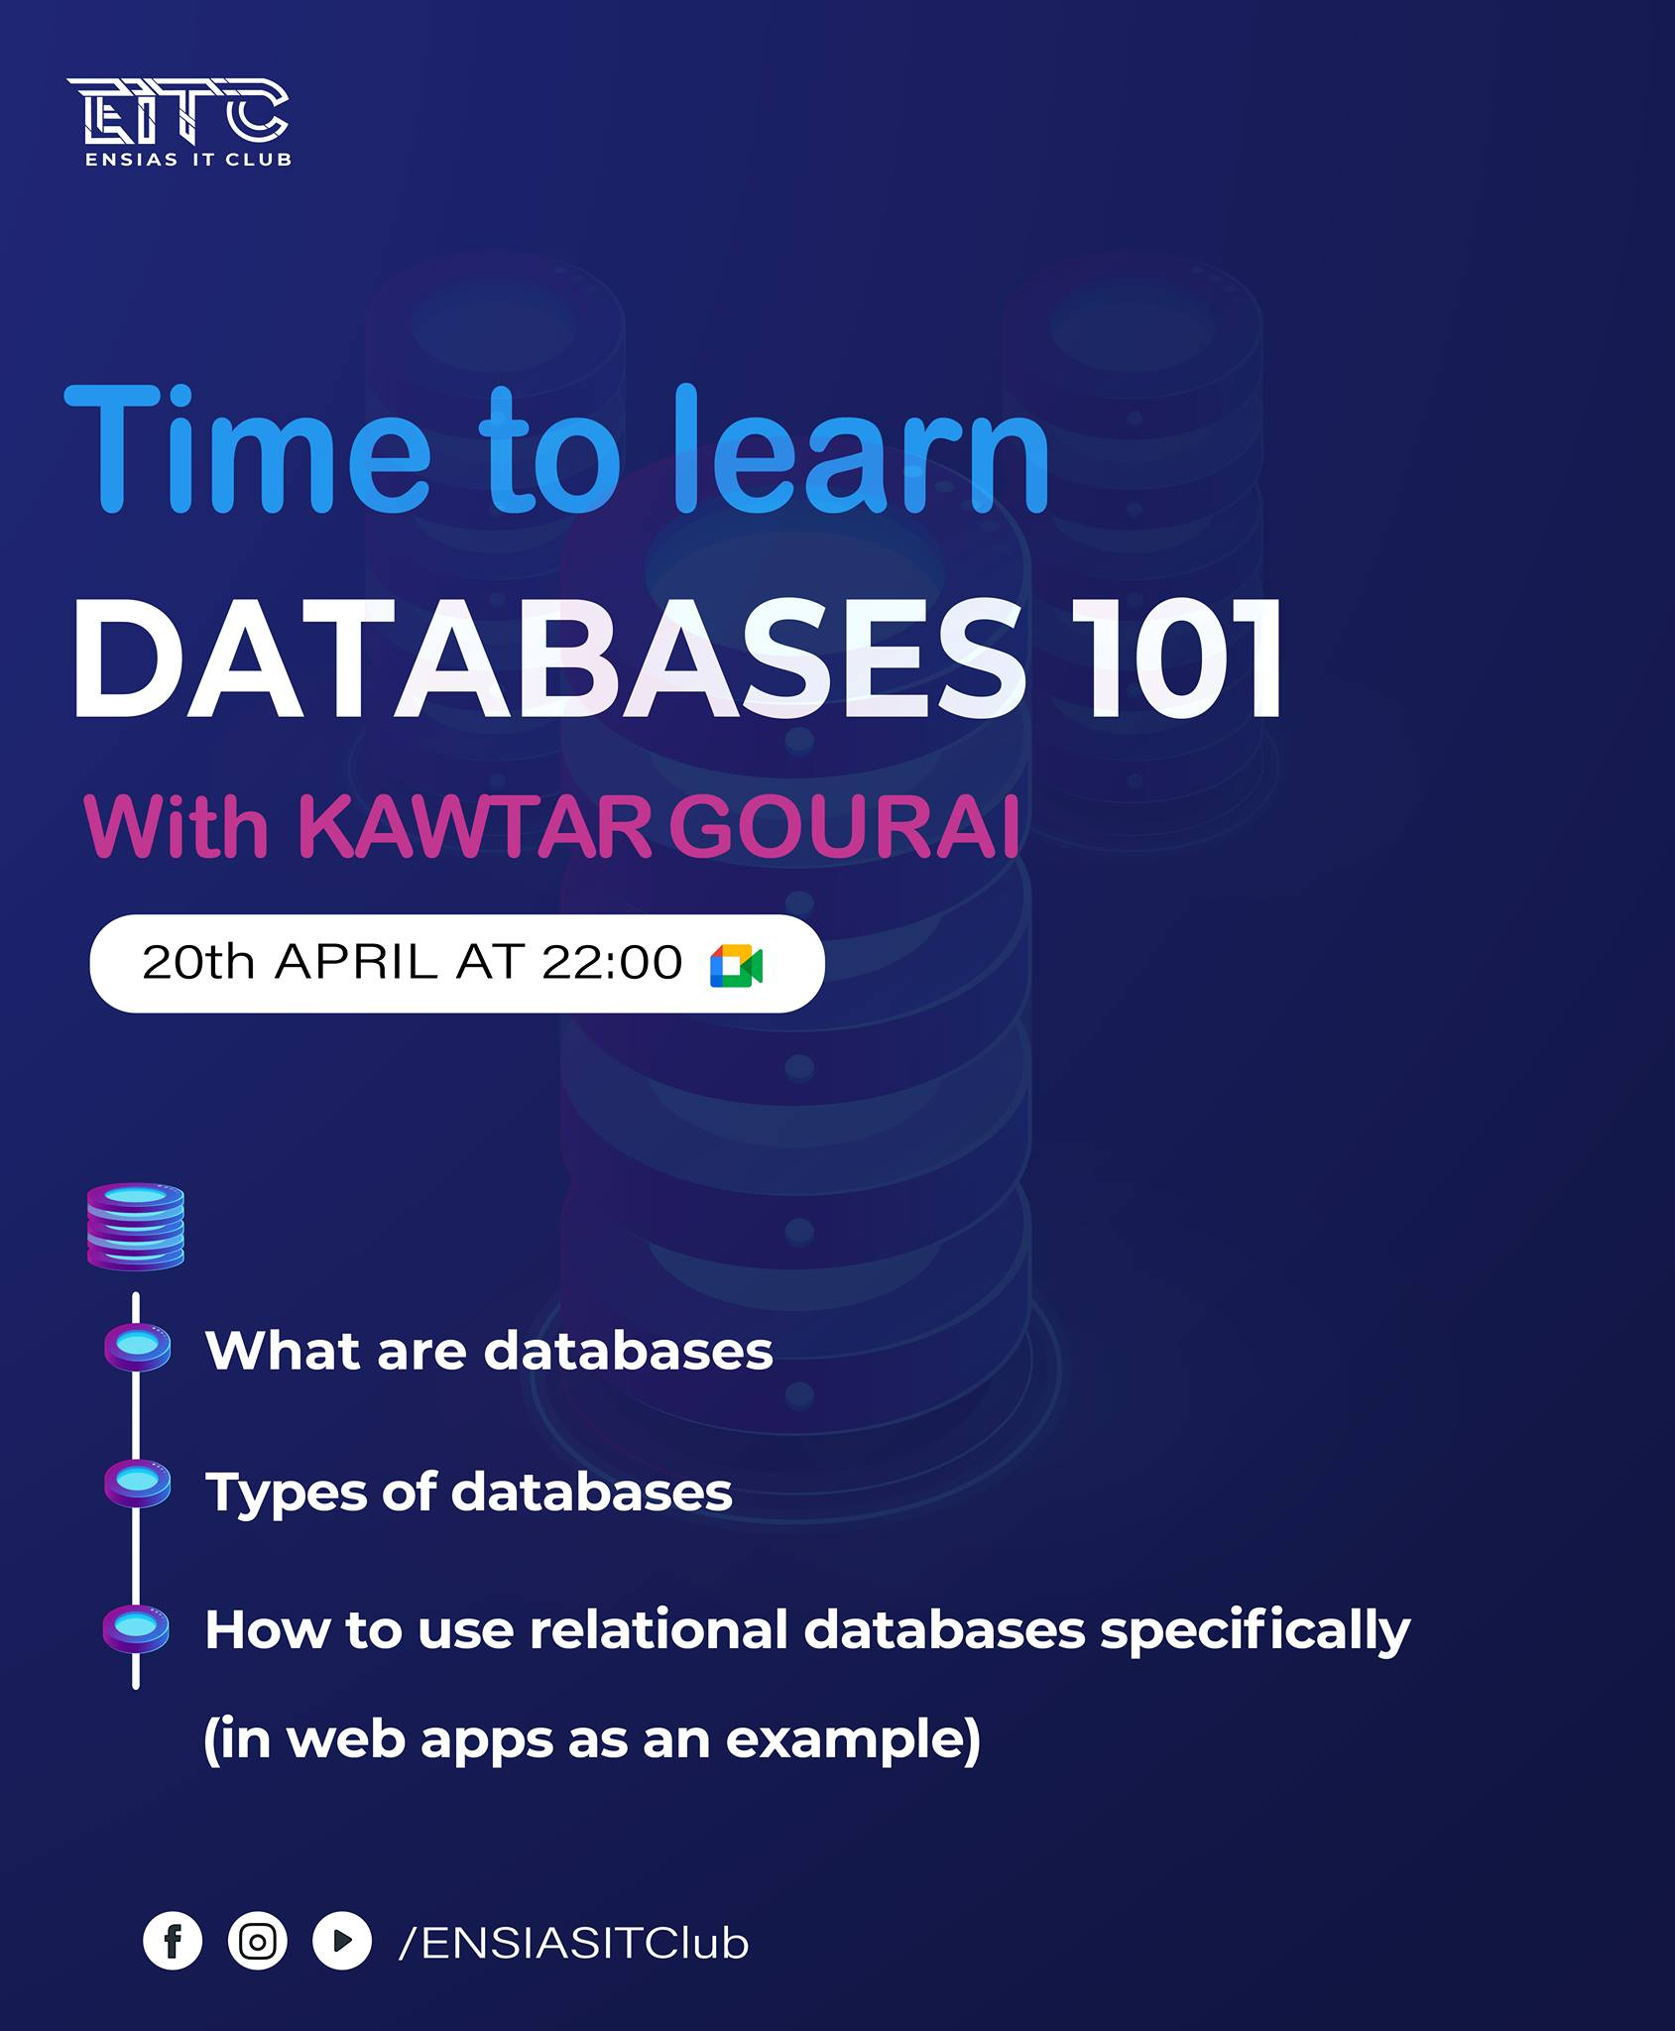
We will start in a few minutes

Slide 2
DATABASES 101
By GOURAI Kawtar

Slide 3
WHAT?
What are databases?
What are the different types of databases?
WHY?
HOW?

Slide 4
What are databases?
Collection of information (data)
Organized and stored
Managed by a DBMS

Slide 5
Why do we use databases?

Slide 6
Types?
Relational databases: tables (columns and rows)
NoSQL databases: allows unstructured and semistructured data to be stored and manipulated
Object-oriented databases: data represented as objects

Slide 7
Distributed databases: 2 or more files located in different sites
Data warehouses: central repositories of data, for fast queries and analysis
Graph databases: store data in terms of entities and the relationships between entities

Slide 8
Other types
We can add cloud databases: collections of data, either structured or unstructured, that reside on a private, public, or hybrid cloud computing platform

Slide 9
How?
How can we use relational databases in web apps?
Implementing CRUD Operations

Slide 10
Create
Delete
CRUD
Read
Update

